Slide 1

Phishing Awareness Training
Understanding and Preventing Phishing Attacks
DADA MUHAMMED THAOBAN
Notes:
DADA MUHAMMED THAOBAN

Slide 2

Introduction
This presentation aims to enhance awareness of phishing attacks, teaching participants how to recognize threats in emails and websites. We will explore various social engineering tactics used by attackers, provide best practices for protecting personal and organizational information, and engage with real-world examples.

Slide 3

01
Phishing Recognition

Slide 4

Identifying phishing emails
Phishing emails often appear legitimate but may contain various indicators of deception. Look for mismatched sender addresses, poor grammar, generic greetings, and urgent requests for personal information. Always verify before engaging with unexpected messages.

Slide 5
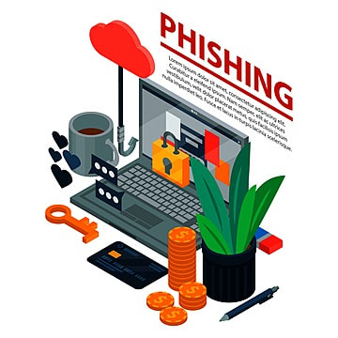
Spotting fake websites
Fake websites often mimic legitimate ones to steal information. Check the URL for misspellings, ensure it uses HTTPS, and avoid clicking links from unknown sources. Use search engines to verify the authenticity of the sites before entering sensitive data.

Slide 6

Red flags in communication
Be aware of red flags that suggest a communication may be phishing. Look for unfamiliar sender domains, attachments from unknown sources, and messages conveying urgency or fear to compel action. Always verify any suspicious requests.

Slide 7

02
Social Engineering Tactics

Slide 8

Common tactics used by attackers
Attackers leverage various social engineering techniques to manipulate individuals into providing confidential information. Common tactics include phishing emails that evoke urgency or fear, impersonation of authority figures, and using deceptive messages that appear to come from trusted sources.

Slide 9
Psychological tricks to elicit information
Social engineers often exploit psychological principles to elicit sensitive information. They may create a sense of urgency, utilize flattery, or instill fear to prompt quick reactions. Understanding these tactics helps individuals recognize and resist manipulation.

Slide 10
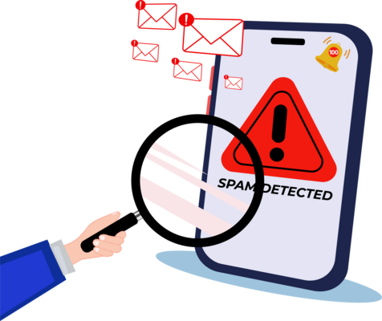
Case studies of successful attacks
Examining case studies of successful phishing attacks offers valuable insights into vulnerabilities exploited by attackers. Notable incidents reveal how attackers mimicked corporate communications or employed common social engineering tactics, leading to significant data breaches and financial losses.

Slide 11

03
Prevention Strategies

Slide 12
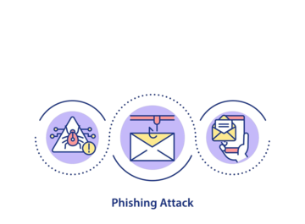
Best practices for email safety
To ensure email safety, regularly update passwords and enable two-factor authentication. Be cautious with unsolicited emails, avoid clicking on suspicious links, and refrain from sharing sensitive information via email unless verified.

Slide 13
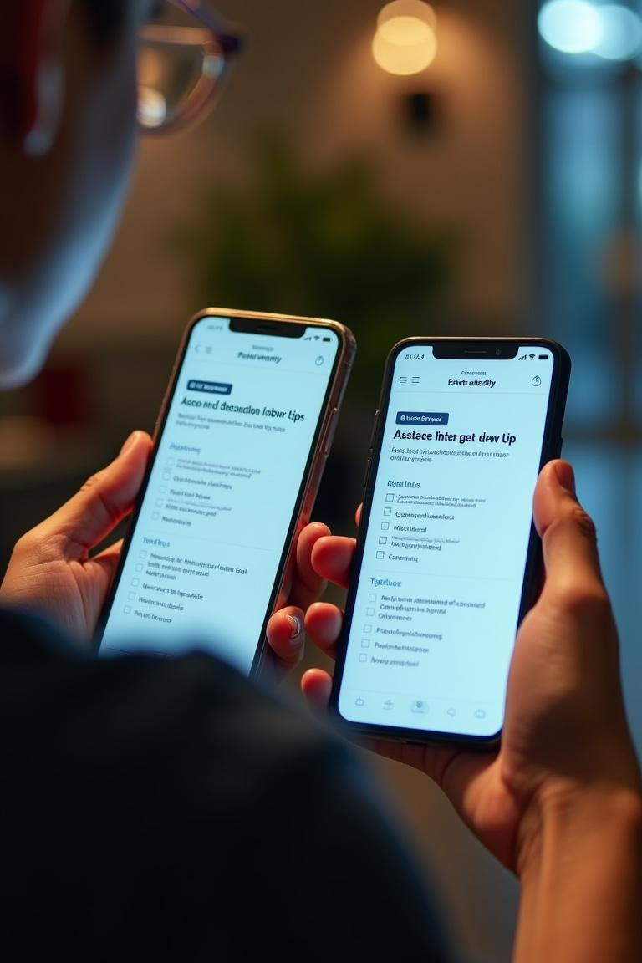
Tips to verify website authenticity
Always check the URL and ensure it begins with 'https://' for secure sites. Look for contact information and verify through independent searches. Avoid entering personal information on unfamiliar websites.

Slide 14
Using security tools and software
Utilize reputable antivirus and anti-phishing software to enhance security. Regularly update these tools and keep operating systems current to protect against known vulnerabilities. Consider additional security measures like virtual private networks (VPNs) for secure browsing.

Slide 15

Conclusions
In conclusion, recognizing phishing attacks and understanding social engineering tactics are essential for personal and organizational safety. By implementing best practices and utilizing security tools, individuals can significantly reduce their risk of falling victim to these threats.

Slide 16
Thank you!
I want to express my gratitude for your time and active involvement in todays presentation program focusing on phishing awareness program.
Happy Learning !!!!!
Dada Muhammed Thaoban

